Slide 1


The Sound of Digital Transformation
Aspire Arduino Program – Bring Your Child to Work Day

Slide 2

What is Digital Transformation?
Digital Transformation is the integration of digital technologies into all aspects of business and human society
Notes:
When talking about how digital transformation
AT&T – Analog switches and NFV
Digital Transformation also affects how businesses operate

Slide 3


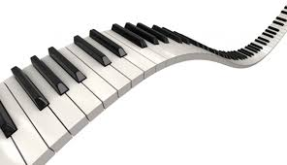
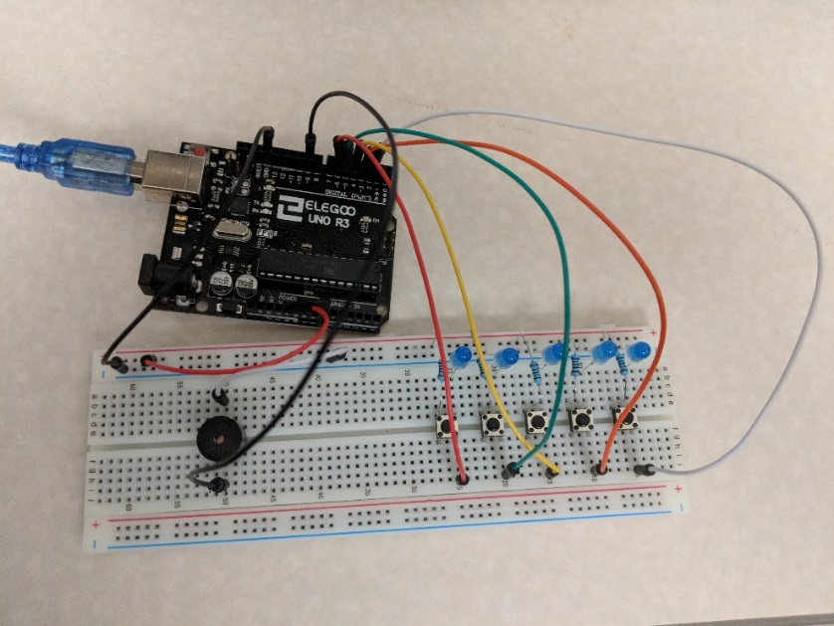
Exercise Introduction
Build a piano using the Arduino and button switches
Digitize the button switches in the program

Slide 4
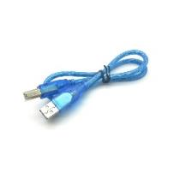
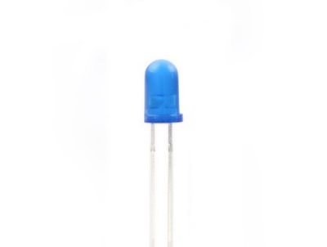
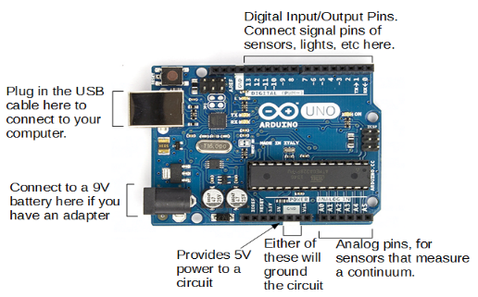
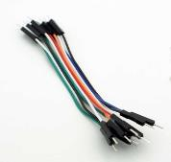
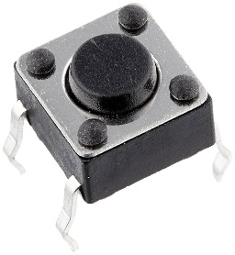
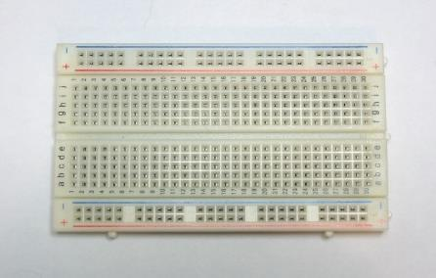
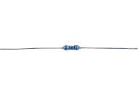
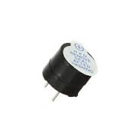
Materials
1 Arduino USB cable
Wires
5 100 Ohm resistor (brown-black-black-black-brown)
1 Arduino Uno
1 breadboard
5 blue LEDs
5 Button Switches
1 active buzzer
Notes:
Some examples of explanations for the different components:
Arduino – functions like a brain. Without it, different components won’t know what to do (i.e. an LED won’t know when to light up).
Breadboard – allows for easy connections between components, and hence easy prototyping. The wires underneath connect pins: all + and – column connected vertically; rows connected horizontally, with the divide in the middle showing a break in the connection (a thru e connected, f thru j connected). Placing components in holes is like a game of battleship.
USB cable – two purposes: to provide power, and to upload code onto the Arduino (Arduino has onboard memory to a set of code, but the replace the code a USB cable is required)
Wires – Also connects different components and rows on the breadboard
Resistor – Slows down the flow of electricity. Some electronics require a lot of electricity, some don’t (hence different sized batteries). Too much electricity can burn components out, so we want to use resistors to limit the power flowing through a circuit.
If kids are really curious about the colors on the resistor, it’s so you can determine how much resistance a resistor has by reading the bands. In our 5 band resistor, the first 3 bands indicate significant figures, the 4th indicates the multiplier, and the 5th indicates tolerance (i.e. brown = 1, or also 1% tolerance, and black = 0; for 100 Ohm we have black brown brown brown black, or 100 x 10^0 within 1% tolerance) (as for orientation, the gap between the tolerance and significant figures bands should be slightly bigger than the rest).
LEDs, Button Switches, and active buzzer are explained later slides.

Slide 5
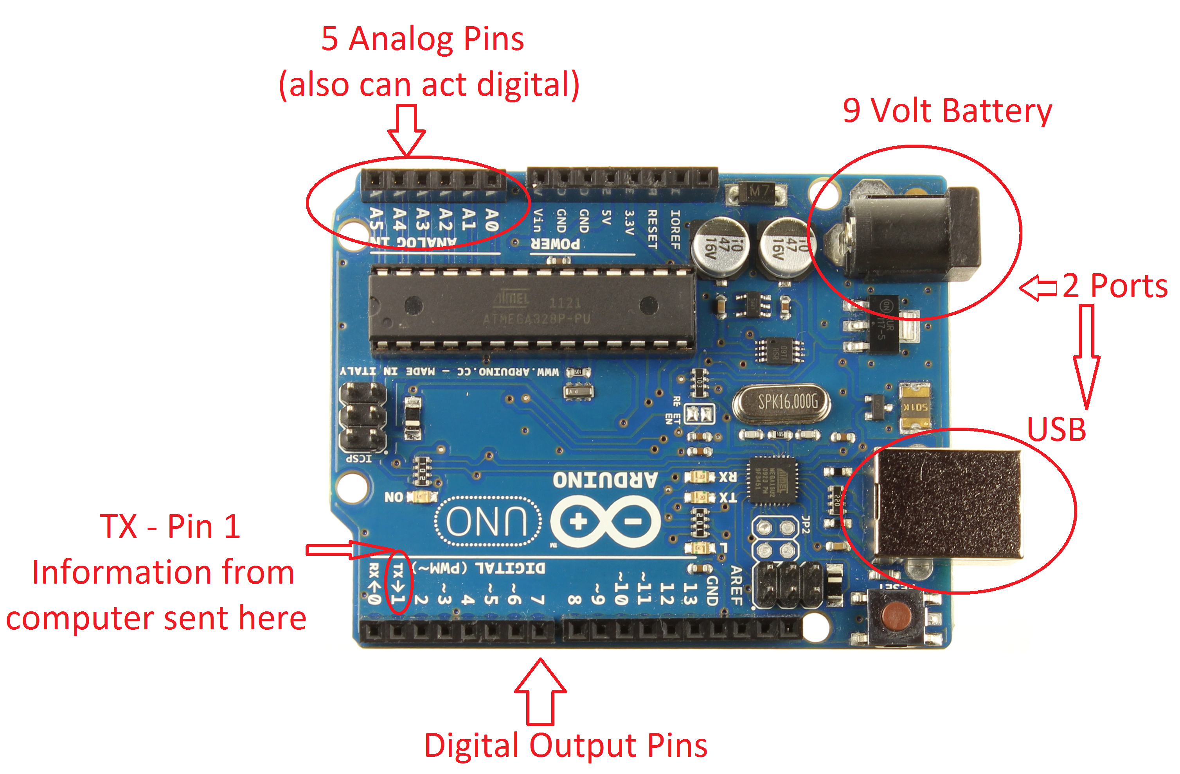
Arduino Intro
Arduino is an open-source electronics platform based on easy-to-use hardware and software.
It's intended for anyone making interactive projects.

Slide 6
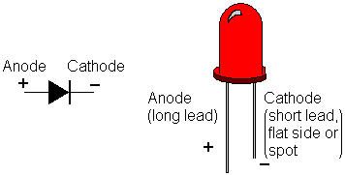
LED intro – Light Emitting Diode (LED)
Notes:
Explain LEDs – Light emitting diode, more commonly known as an LED, that is a two lead semiconductor source. It is a p-n junction diode, which emits light when activated. More simply, if you put a power source to the right end, it will light up.
Explain/Identify cathode and anode – The cathode is the negative end and the anode is the positive end. You can tell which is which by identifying which is the shorter end and which is the longer end. The anode is the longer end and the positive side. The cathode is the shorter end and the negative side. This will be important for making the traffic light, so remember this. Maybe, make a pneumonic.
Tell kids to take LEDs and make a wider V (suggestion)

Slide 7
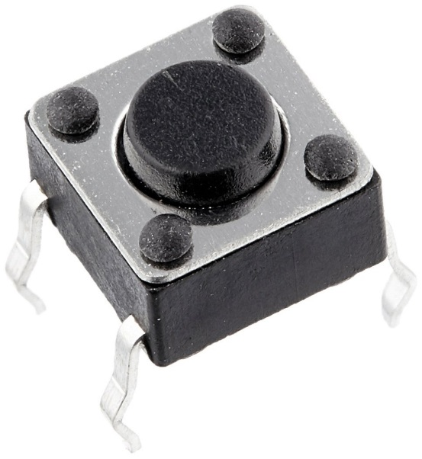
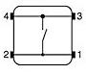
Button Switch Intro
Controls whether a circuit is open or closed, whether electricity flows through the circuit or not
Pressing the button means closing the switch, connecting 1-2 to 3-4
Notes:
You can use relationship to a light switch.
To tell orientation, the legs should be on sides, not top and bottom.

Slide 8
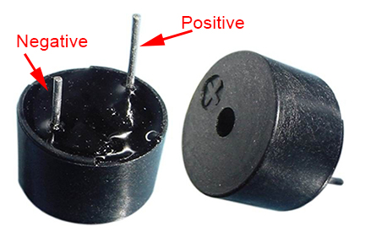
Active Buzzer Intro
When a DC voltage is applied, an oscillator is activated
An oscillator is a piece of material that vibrates when current flows through it
These vibrations make noise, just like your vocal chords
Notes:
Remember, buzzers are diodes too, so orientation matters.
If kids are curious, a passive buzzer requires AC signal to vibrate and make sound, while an active buzzer can use a DC current (the passive buzzer lacks the internal oscillator).
If kids are super curious about how the sound is produced, the Arduino would alternate feeding electricity to the buzzer and not at quick and equal time intervals. This produces waves (square waves, not sinusoidal like waves normally are thought of), with the period being defined as one cycle of the buzzer vibrating and then not vibrating. The frequency, or what we use to measure “pitch”, is calculated by 1/period.

Slide 9
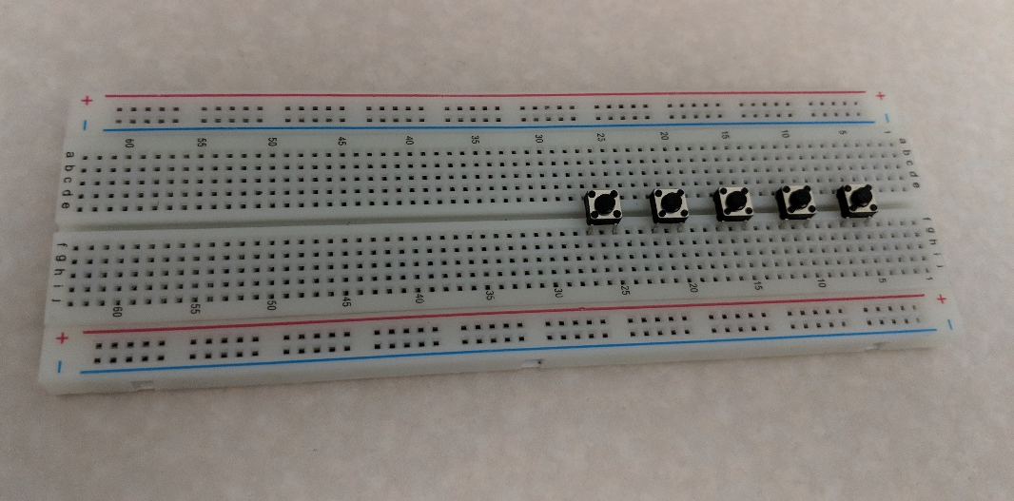
Adding the Switches
Place 5 buttons with their legs plugged into the following holes:
Button 1: e5, e7, f5, f7
Button 2: e10, e12, f10, f12
Button 3: e15, e17, f15, f17
Button 4: e20, e22, f20, f22
Button 5: e25, e27, f25, f27

Slide 10
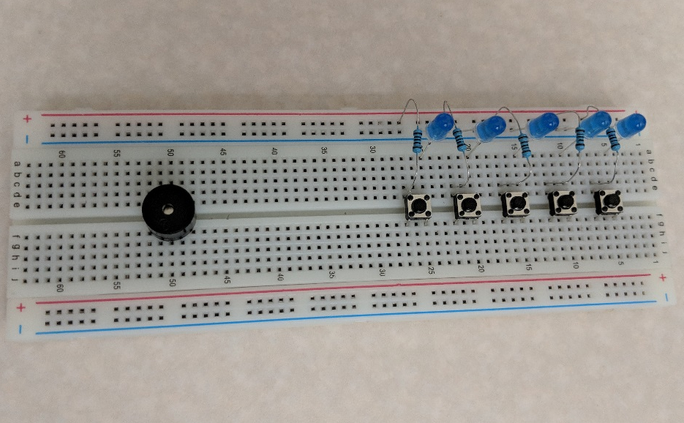
Creating Circuits
Connect resistors to the switch:
Place a resistor from (+)7 to d7
Place a resistor from (+)12 to d12
Place a resistor from (+)17 to d17
Place a resistor from (+)22 to d22
Place a resistor from (+)27 to d27
Connect LEDs to the switch:
LED1: short leg in (-)5, long leg in a5
LED2: short leg in (-)10, long leg in a10
LED3: short leg in (-)15, long leg in a15
LED4: short leg in (-)21, long leg in a20
LED4: short leg in (-)25, long leg in a25
Notes:
There is some confusion with the numbers. To clear up, when I write (+)7, I mean the hole in the same line as d7, so the resistor should be placed parallel to the top edge of the board. (But does it even matter which row you place something in the (+) and (-) columns? Good question to ask the kids)

Slide 11
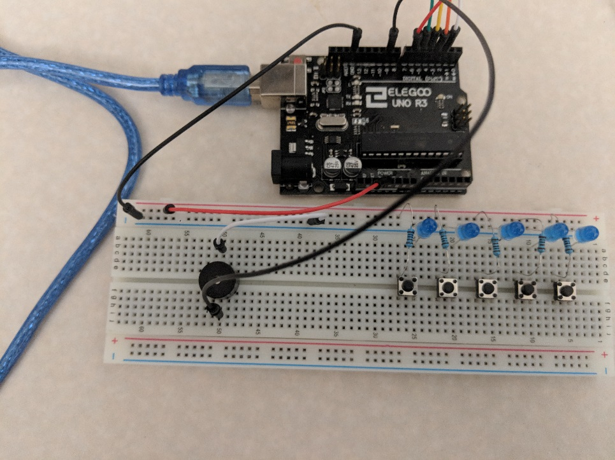
Adding the Buzzer
Buzzer: place the short end in e50, long end in f50
Connect Power and Ground:
Connect 5V on the Arduino to (+)55
Connect GND on the Arduino to (-)60
Connect the Buzzer to Power and Ground
Connect digital 9 on the Arduino to i50
Connect a50 to (-)40

Slide 12
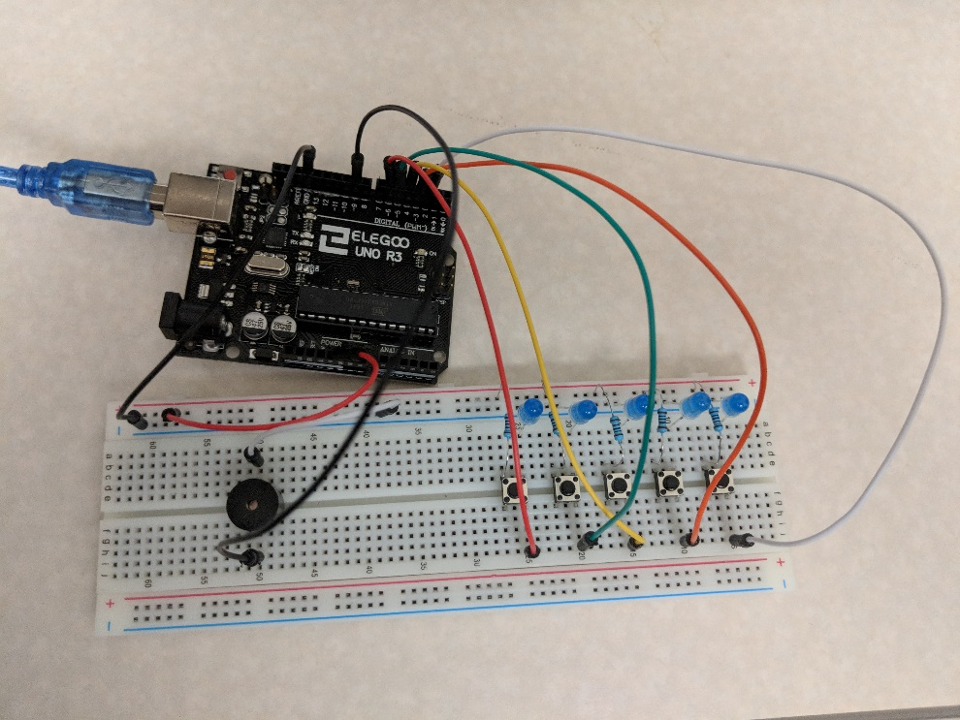
Adding Digital Inputs
Connect wires from the switches to the Arduino
Connect a wire from j5 to Arduino digital 2
Connect a wire from j10 to Arduino digital 3
Connect a wire from j15 to Arduino digital 4
Connect a wire from j20 to Arduino digital 5
Connect a wire from j25 to Arduino digital 6

Slide 13
Uploading the Code
Plug the Arduino into the laptop with the USB cable
Open “piano.ino”
Map the COM port to the Arduino and upload the code
Can modify the code to change the frequencies
Notes:
Make sure to explain the code a bit.

Slide 14
Digitizing the Piano Setup
Open “piezo.ino”
Upload the code to the Arduino
Notes:
Try playing a song of your own creation.

Slide 15
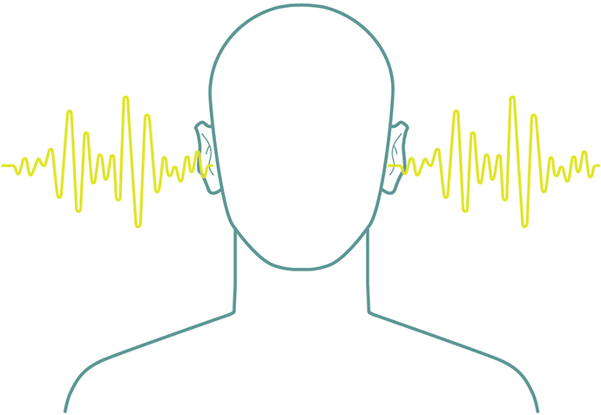
Sample Discussion Questions
Can you think of any ways you can further digitize this piano setup?
What are the benefits of having the digital setup vs the analog? What are the challenges?
Can you think how this transition to digital technologies affect the way businesses operate?

